Slide 1
Economical Classification of Countries World Bank Study
Data Science Bootcamp
09/26/2019
Group Members: Hiral Patel, Poonam Gupte, and Santosh Singh

Slide 2
About World Bank
World Bank categorizes countries based on various characteristics, such as geography, lending eligibility, fragility, and average level of income, to help shed light how different groups of countries are doing. When it comes to income , the World Bank divides the world's economies into four income groups:
High
Upper-Middle
Lower-Middle
Low

Slide 3
End to End Process
Data normalization and storage
Extract and data cleansing
Visualizations

Slide 4

Tools and Technology
Python Flask–powered RESTful API
HTML/CSS, Bootstrap
D3
Java Script, (CanvasJS)
LeafLet
Plotly
Mapbox

Slide 5
Data Analysis
Higher average incomes
Lower unemployment
Lower government borrowing
Improved public services
Money can be spent on protecting the environment Investment
Increased research and development

Slide 6
Data Analysis
China’s ranking in the world’s ten largest economies has sure bounced around a lot.
It was the world’s fifth largest economy in 1962 and remained in the top ten economies until it dropped out in 1978 and 1979, before returning in 1980, dropping out again for a few years and returning to the top ten in 1982.
In 1987, China fell out for a year, came back in 1988, dropped out again in 1989 before returning to the top ten for good in 1992.
As of 2017, the US economy at $19.4 trillion was 58.4% larger than China’s GDP of $12.2 trillion.

Slide 7
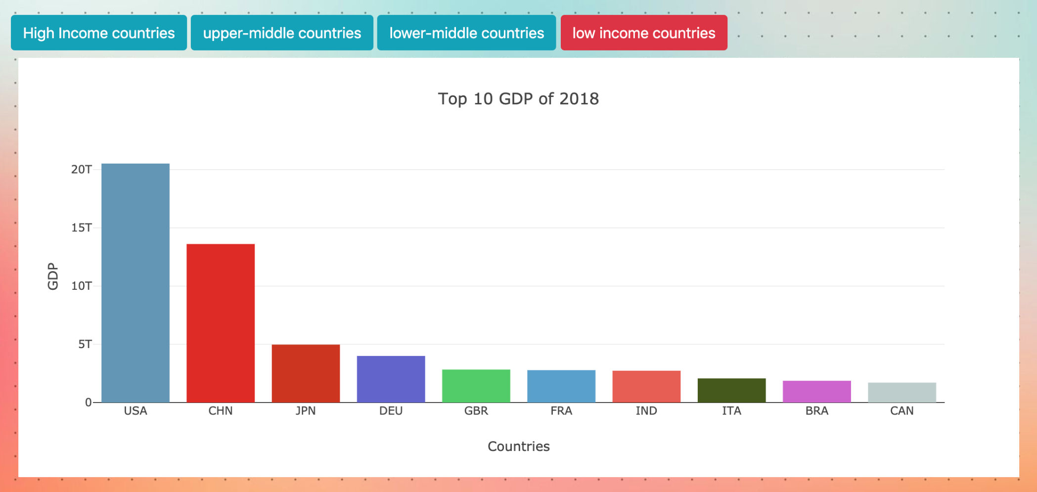
Top Ten Economies of the World

Slide 8
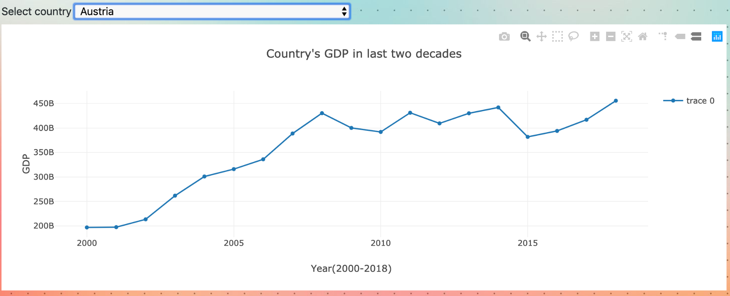
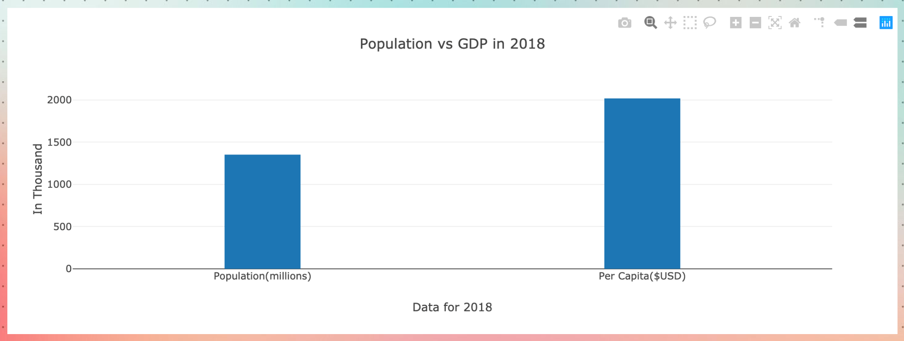
Classification of Countries by GDP

Slide 9
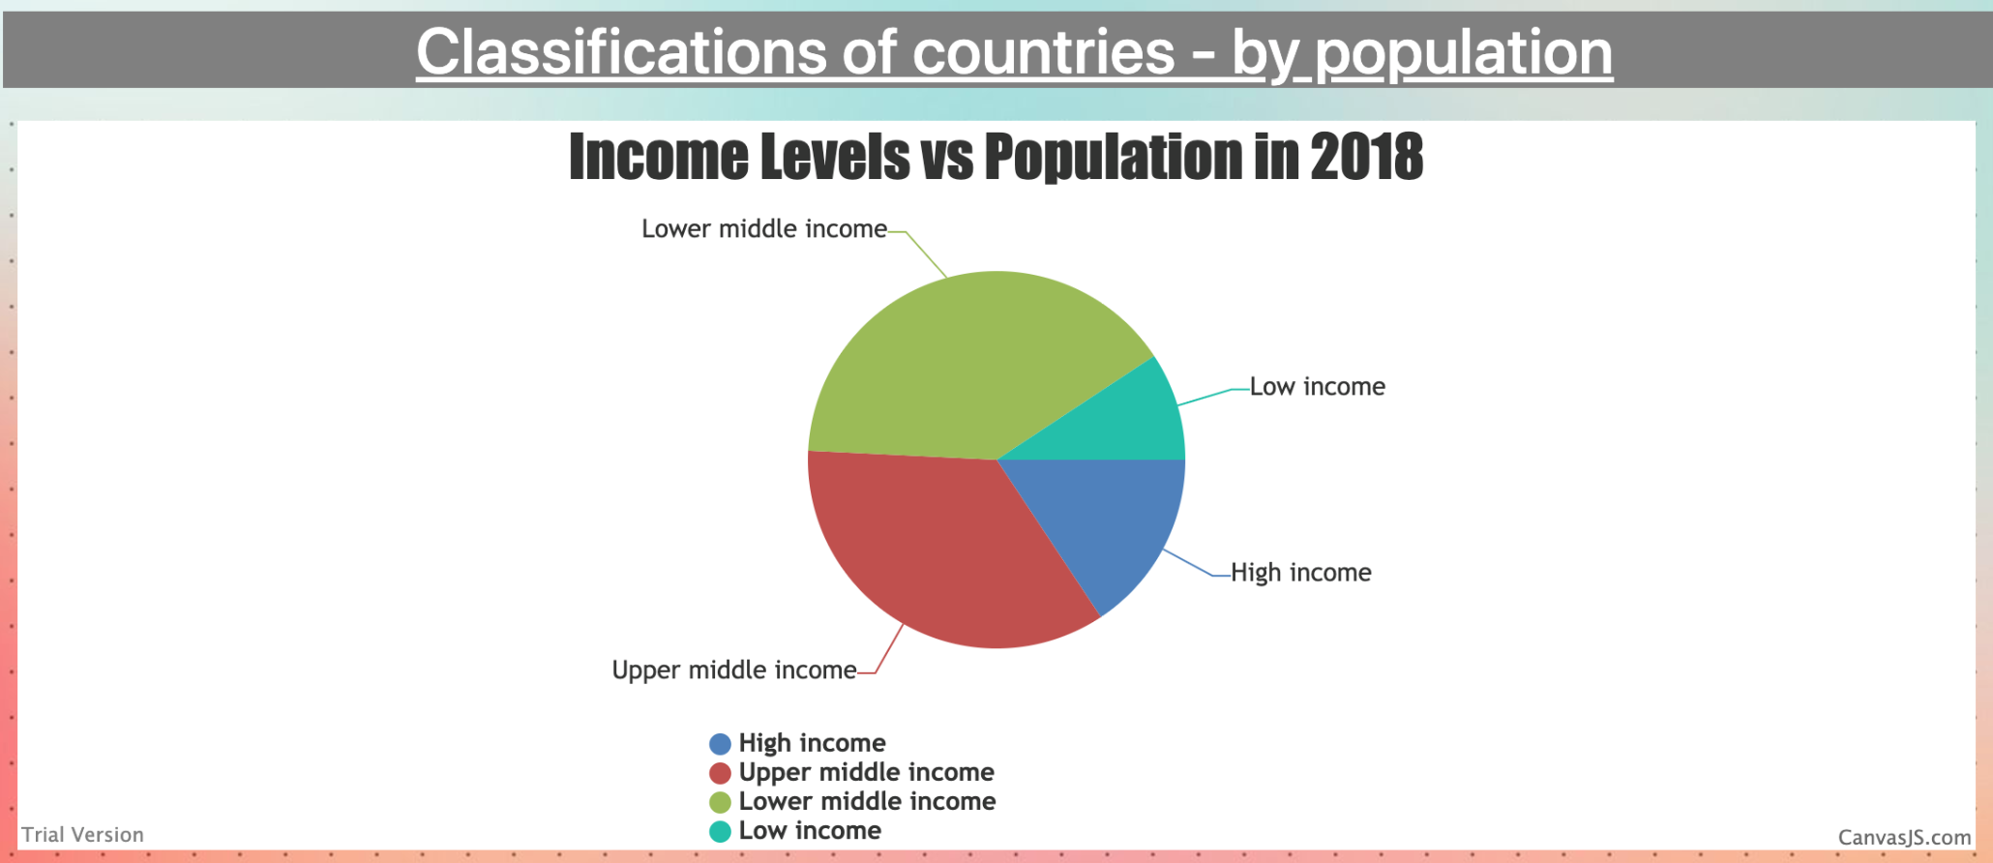
Country GDP/Population
40% Low mid
9% Low
14% High
37% Upper Middle

Slide 10
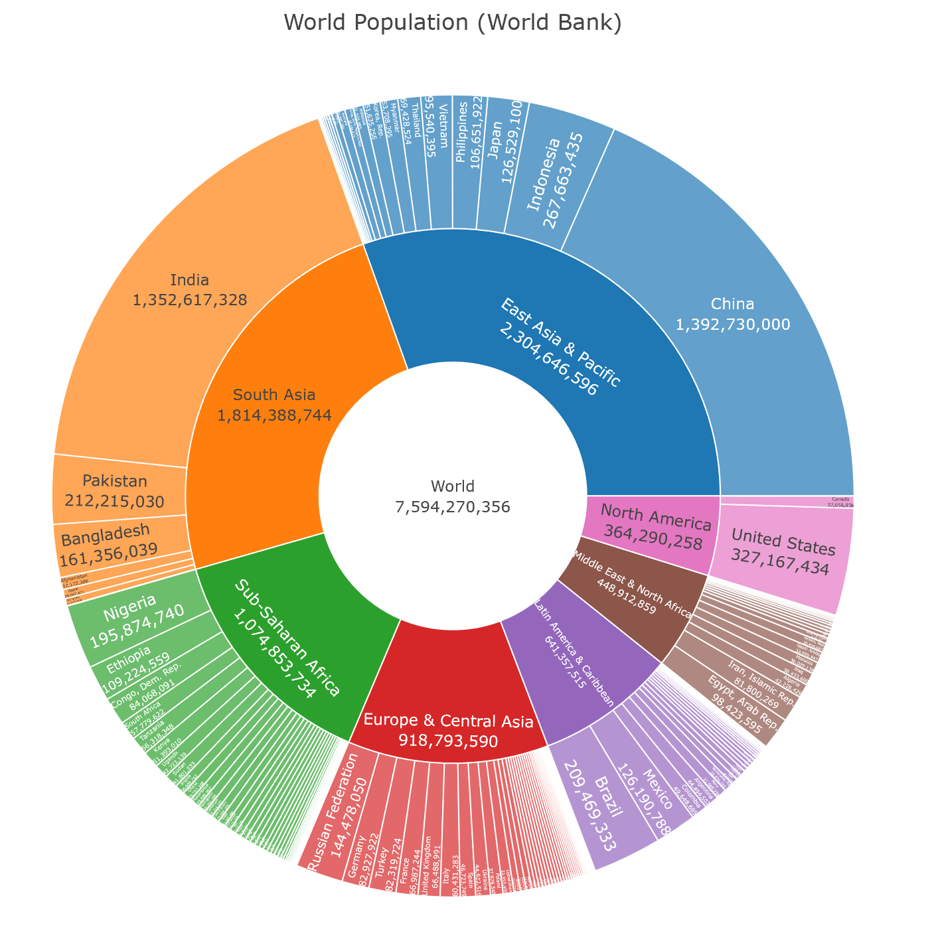
World Population Analysis

Slide 11
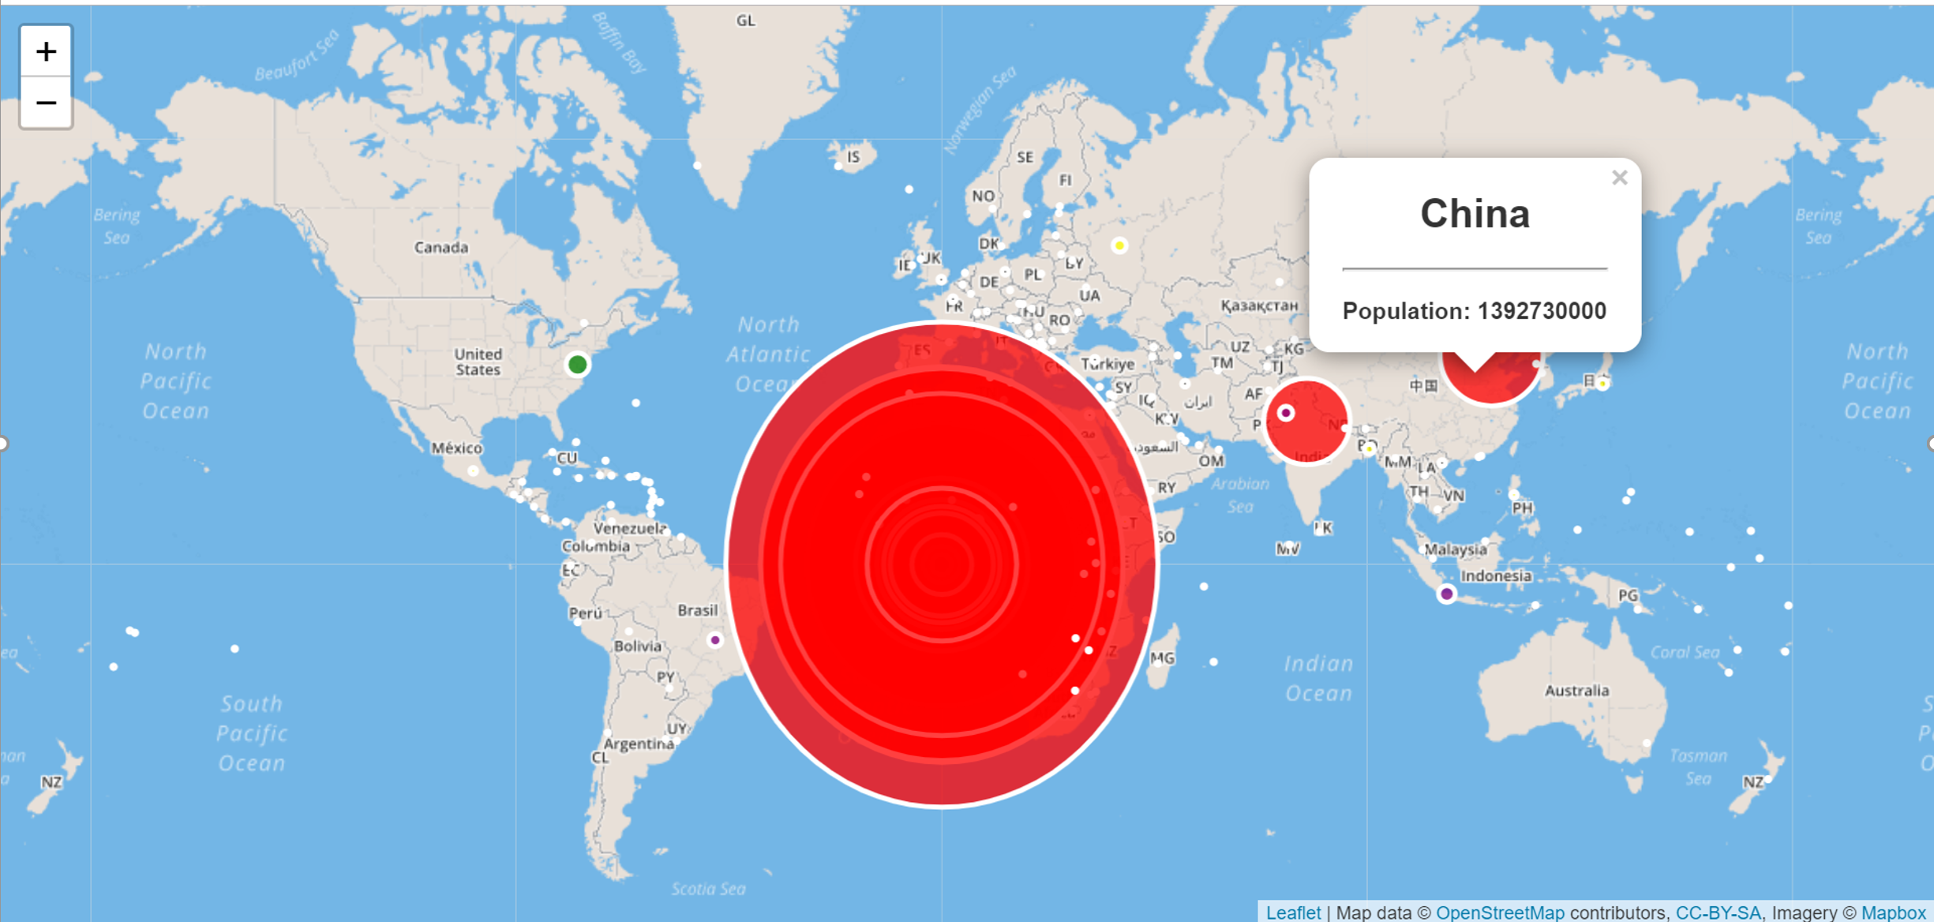
Population view on world map

Slide 12
Live Demo

Slide 13


Questions?
PGSQL

